Slide 1




Bootcamp
Skills Test
HA UG
2022

Slide 2
Crop modeling
{DSSAT}
HA UG
2022

Slide 3






Yield
ORACLE
2023
C7081
2021

Slide 4









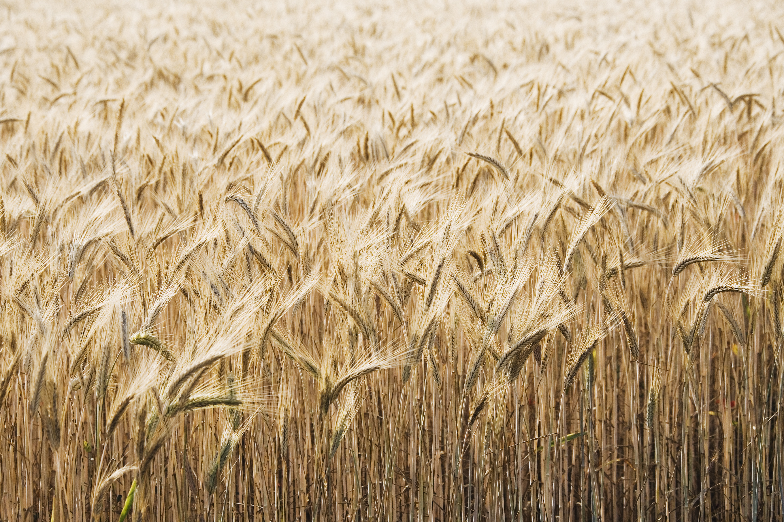


















Slide 5


Q
C7081
2021
antine

Slide 6
Q
antine
Q
antine

Slide 7


HARPE
D
D
HARPE
HARPE
T
T
A
A
2021
HA UG!
D
HARPE
T
2021
A

Slide 8
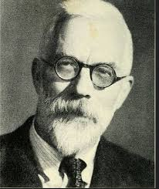

HARPE
HARPE
DATA
SCIENCE
HARPE
HARPE
DATA
SCIENCE

Slide 9

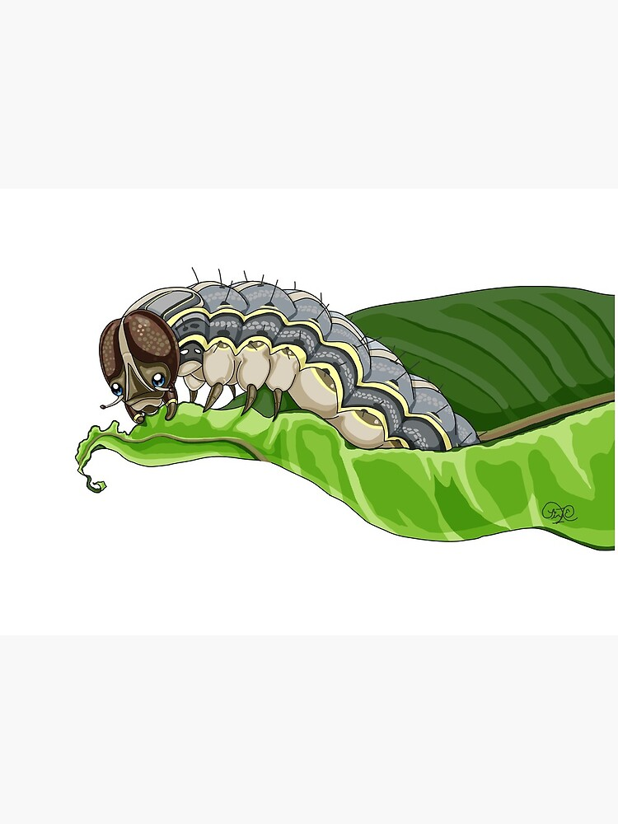
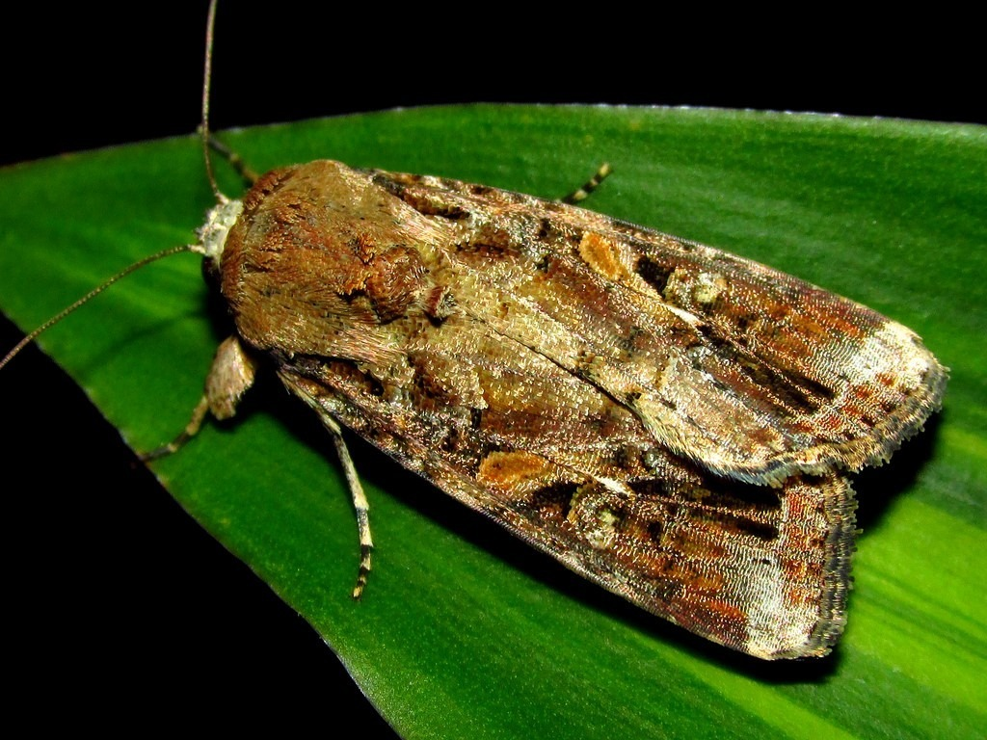






DS
EDA
2021
GA
AGE
DS
2021
DATA
SCIENCE
DS
GA
AGE

Slide 10




Slide 11
Viz!
Non-linear
HA UG
2022

Slide 12
Oh my!
Loops and lmer
HA UG
2022

Slide 13
Ch 04
Spatial Data
HA UG
2022

Slide 14
Ch 03
Spatial Data
HA UG
2022

Slide 15
Ch 01-02
Spatial Data
HA UG
2022

Slide 16
{leaflet}
Maps in R
HA UG
2022

Slide 17
Ch 03
Advanced R
HA UG
2022

Slide 18
Scrape the
Web!
Twitter data
HA UG
2022

Slide 19
Keras
in R!
Deep Learning
HA UG
2022

Slide 20
Control structures
and flow!
R programming
HA UG
2022

Slide 21
Memory use
Advanced R
HA UG
2022

Slide 22
Yolov5 for
Custom data!
HARPE
DATA
SCIENCE

Slide 23
Using SADIE
in R
Spatial data
HA UG
2022

Slide 24
Big Data Projects
HARPE
DATA
SCIENCE

Slide 25
Web Automation in R
Automation
HA UG
2022

Slide 26
Web Automation in R
Automation
HA UG
2022

Slide 27

Github webpage
R analysis

Slide 28
LME + blocking
R analysis

Slide 29


Data Viz

Slide 31
NLP
Sentiment analysis
HARPE
DATA
SCIENCE

Slide 32
Sample size?
R simulation

Slide 33
NLP basics
HARPE
DATA
SCIENCE

Slide 34
T-test
R Bootcamp
2.5

Slide 35
Regression
R Bootcamp
2.4

Slide 36
Correlation
R Bootcamp
2.3

Slide 37
Distributions
R Bootcamp
2.2

Slide 38
summarizing
data
R Bootcamp
2.1
HARPE
DATA
SCIENCE

Slide 39
HAP-E
Machine learning
concept
HARPE
DATA
SCIENCE

Slide 40
HAP-E
Stats basics
HARPE
DATA
SCIENCE

Slide 41
HAP-E
Data wrangling
HARPE
DATA
SCIENCE

Slide 42
HAP-E
Python graphs
HARPE
DATA
SCIENCE

Slide 43
HAP-E
Python setup
HARPE
DATA
SCIENCE

Slide 44
manipulating
data
R Bootcamp
1.5
HARPE
DATA
SCIENCE

Slide 45
R Bootcamp
1.4
HARPE
DATA
SCIENCE

Slide 46
R Bootcamp
1.3
HARPE
DATA
SCIENCE

Slide 47
Github
Website
HARPE
HARPE
DATA
SCIENCE
SCIENCE

Slide 48


R Bootcamp
0.0 overview
HARPE
HARPE
DATA
SCIENCE
SCIENCE

Slide 49
R Bootcamp
0.1 RStudio
HARPE
HARPE
DATA
SCIENCE
SCIENCE

Slide 50
R Bootcamp
1.1 R Syntax
HARPE
HARPE
DATA
SCIENCE
SCIENCE

Slide 51
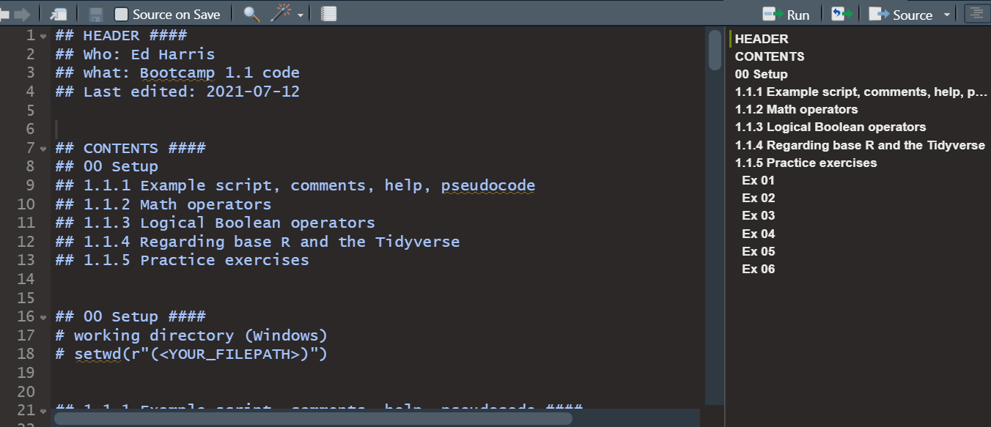
R Bootcamp
1.1 R Syntax
HARPE
HARPE
DATA
SCIENCE
SCIENCE

Slide 52
R Bootcamp
1.2 Functions
HARPE
HARPE
DATA
SCIENCE
SCIENCE

Slide 53
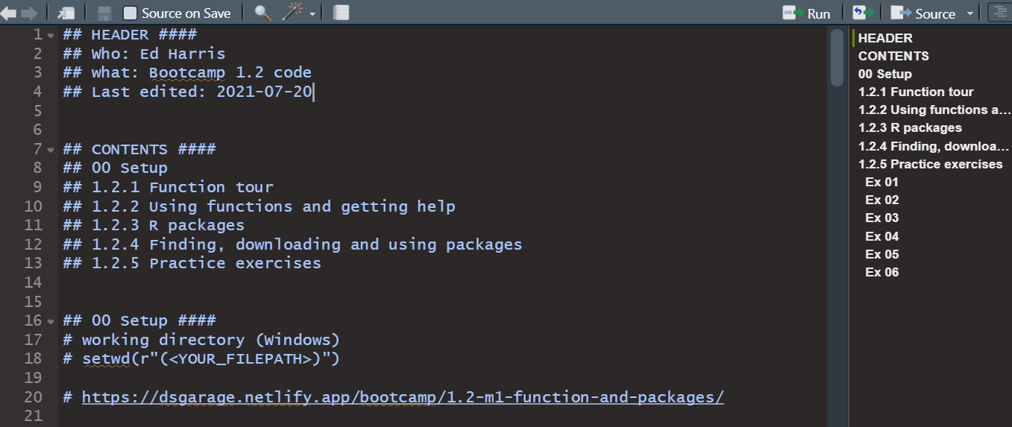
R Bootcamp
1.2 Functions
HARPE
HARPE
DATA
SCIENCE
SCIENCE

Slide 54

shinycustomloader
shinycustomloader
shinycustomloader
shinycustomloader
shinycustomloader
shinycustomloader
shinycustomloader
shinycustomloader
http://hexb.in/sticker.html

